Slide 1
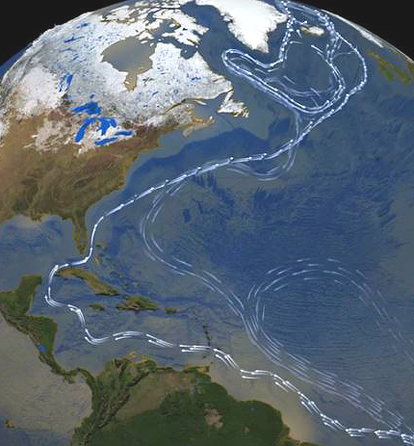
The Physics-informed AI Climate Model Agent Neuro-symbolic Simulator (PACMANS) for Tipping Point Discovery Virtual Onsite Visit April 6, 2022
Jennifer Sleeman, Ph.D.
Jay Brett, Ph.D.
Marisa Hughes, Ph.D.
Anand Gnanadesikan, Ph.D.
Yannis Kevrekidis, Ph.D.
DISTRIBUTION STATEMENT A: Approved for public release: distribution unlimited.

Slide 2
Project Team
The Physics-informed AI Climate Model Agent Neuro-symbolic Simulator (PACMANS) for Tipping Point Discovery
APL Team: Jennifer Sleeman PI, Jay Brett, Marisa Hughes, Anshu Saksena, Chace Ashcraft, David Chung, Larry White
JHU Team: Anand Gnanadesikan (Co-PI), Yannis Kevrekidis (Co-PI), Thomas Haine, Marie-Aude Pradal, Renske Gelderloos
UC Davis: Grey Nearing (Unpaid collaborator) (Hydrology and Bayesian Expertise)
20 April 2022

Slide 3
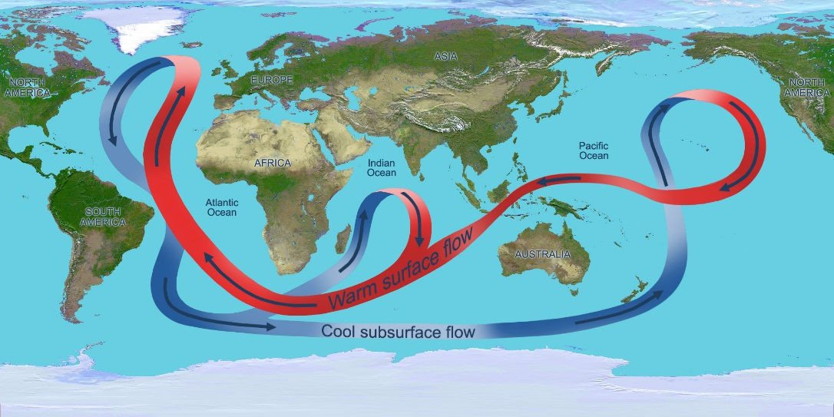
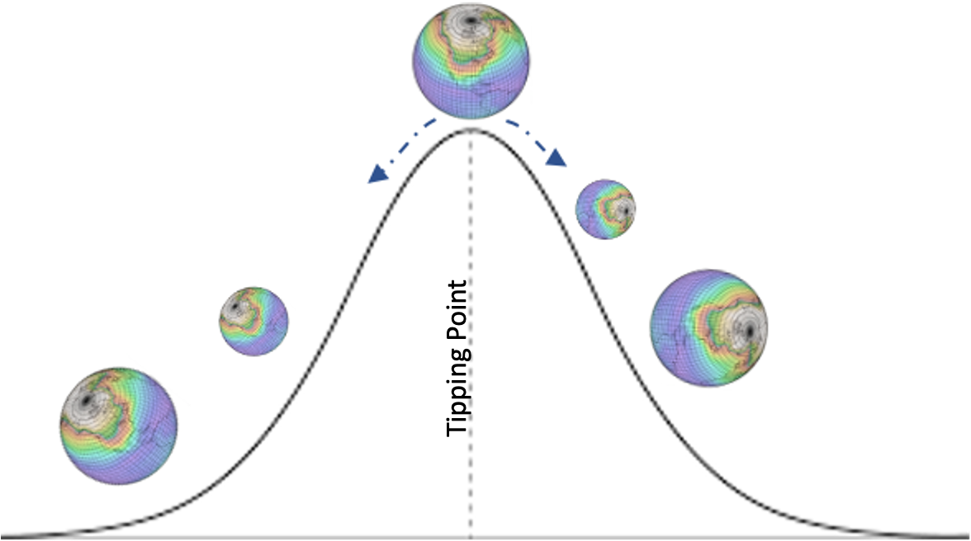
Motivation
The Physics-informed AI Climate Model Agent Neuro-symbolic Simulator (PACMANS) for Tipping Point Discovery
Boers (2021) described the global effects of the instability of the Atlantic Meridional Overturning Circulation (AMOC)
Almost complete loss of stability could have devastating effects on:
food security,
rising sea levels,
arctic related effects and
vulnerable ecosystems
The AMOC (NASA)
Due to the effects (that are known) of a complete instability of the AMOC, there is a strong sense of urgency in both understanding and identifying the AMOC tipping point

Slide 4
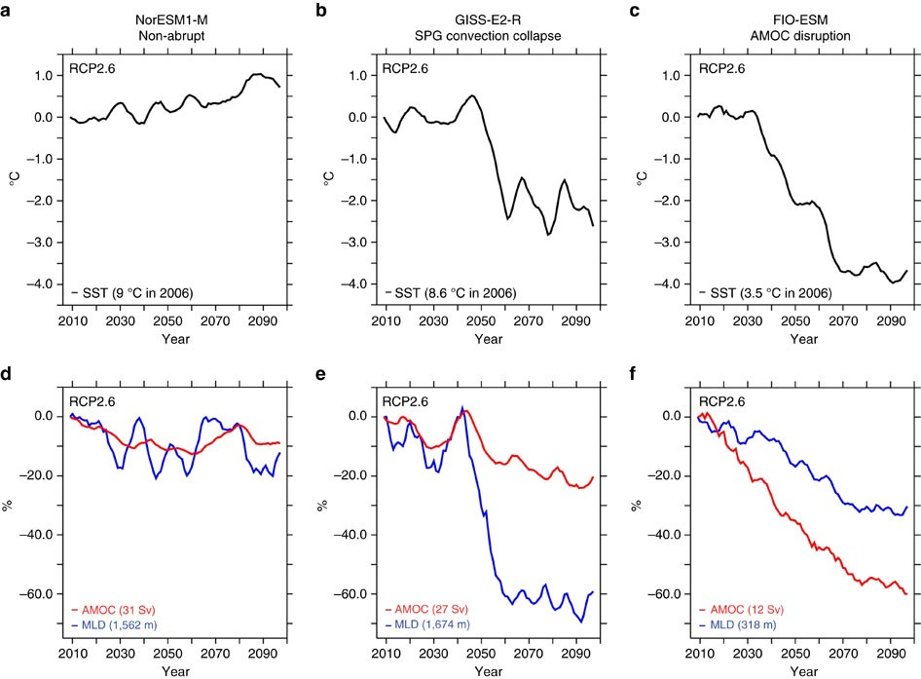
AMOC Climate Modeling Challenges
The Physics-informed AI Climate Model Agent Neuro-symbolic Simulator (PACMANS) for Tipping Point Discovery
Ocean data is sparse
Historical records limited mainly to ship tracks
biases data to Northern hemisphere
Satellites and autonomous floats increase available data
Still limited to the surface for satellites and to a sparse array of locations with drifters
Computational Limitations
Asking questions of the model prohibitive
Model disagreement
Different systems
Different parameters sets within a system
Example of General Circulation Model (GCM) outcomes that expose disagreement among models

Slide 5
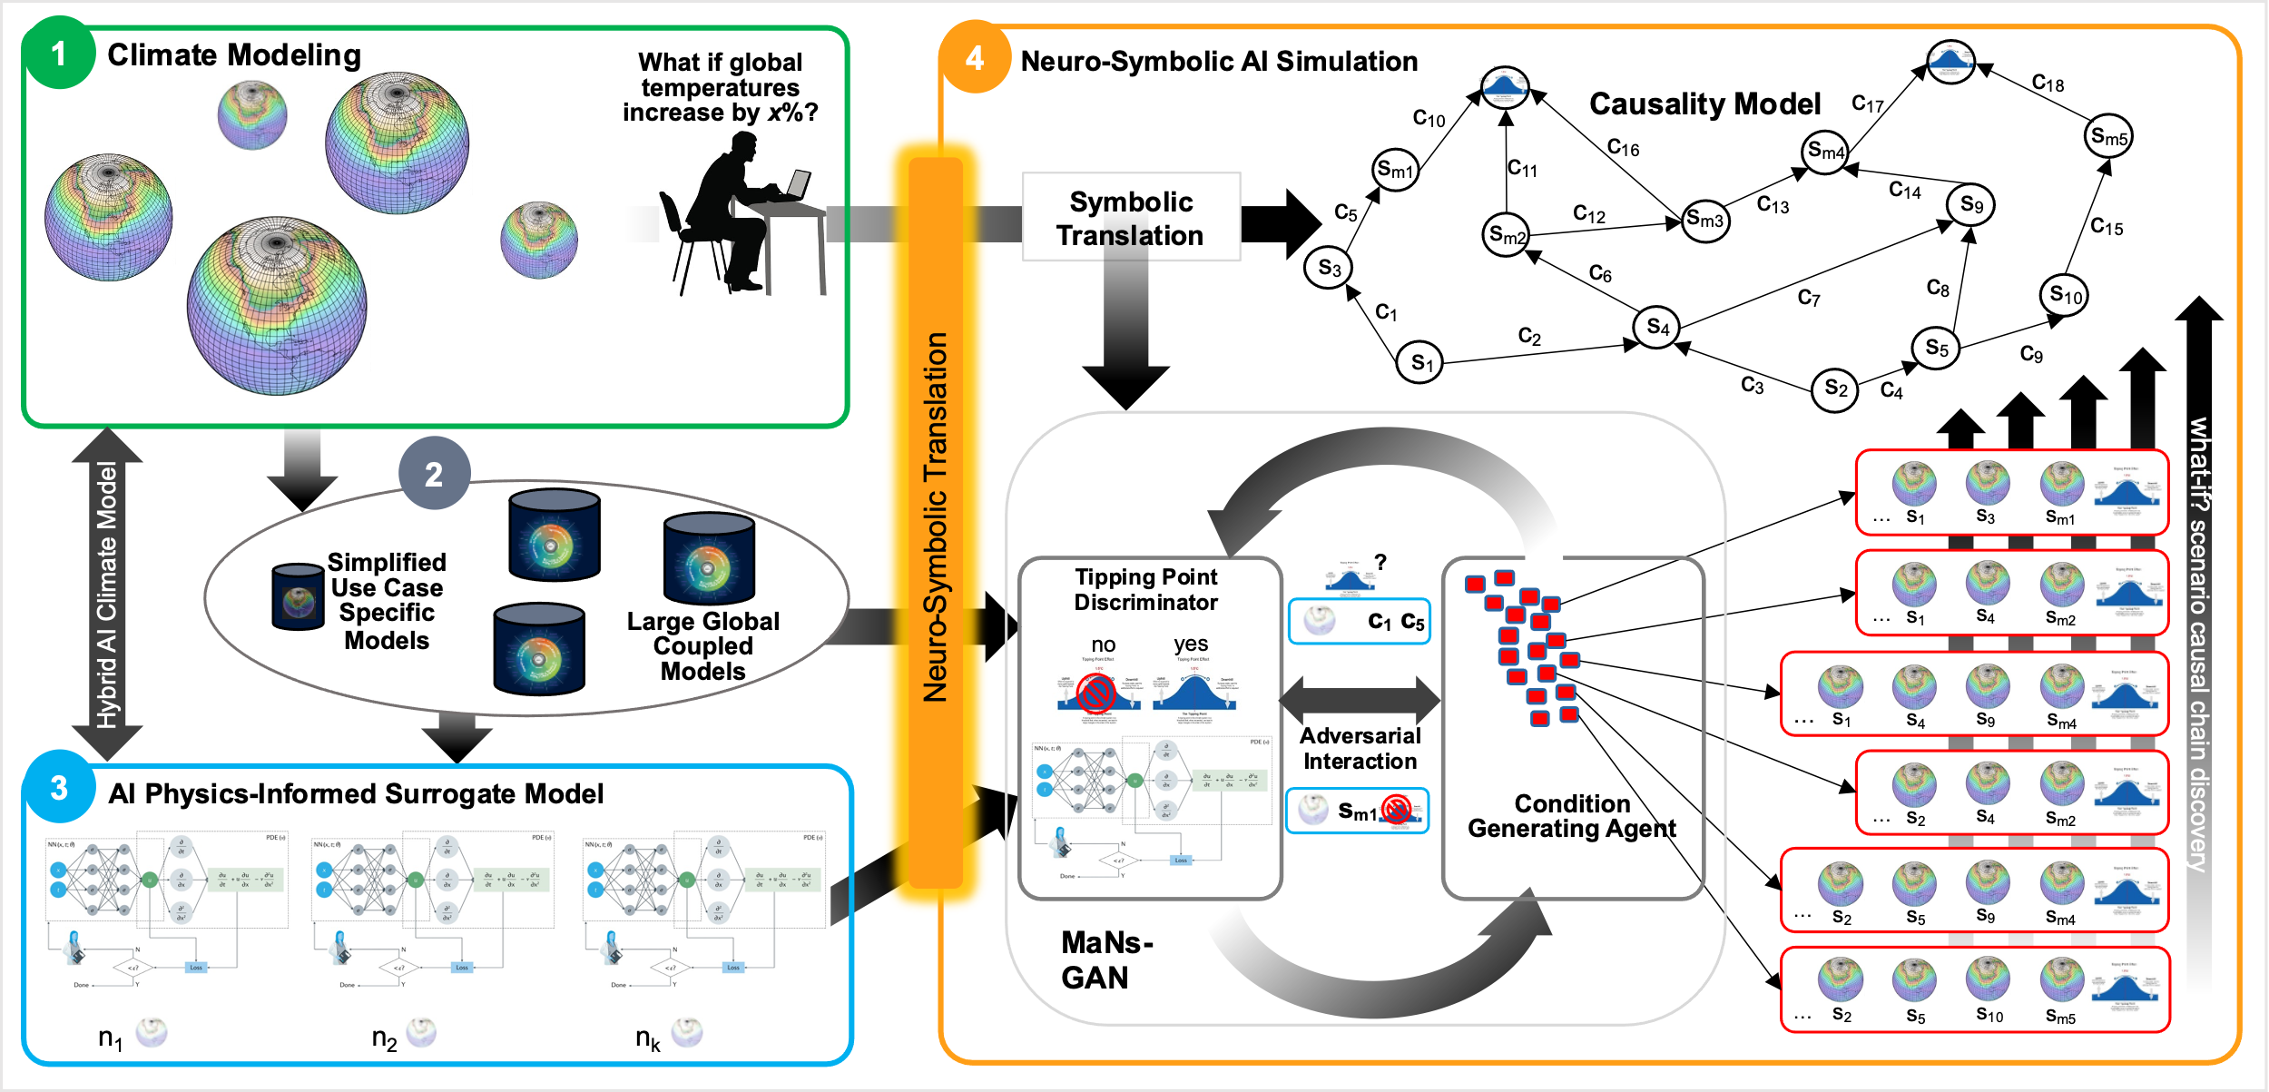
PACMANs
The Physics-informed AI Climate Model Agent Neuro-symbolic Simulator (PACMANS) for Tipping Point Discovery
The Physics-informed AI Climate Model Agent Neuro-symbolic Simulator (PACMANS) for Tipping Point Discovery Framework

Slide 6
PACMANs
The Physics-informed AI Climate Model Agent Neuro-symbolic Simulator (PACMANS) for Tipping Point Discovery
The Physics-informed AI Climate Model Agent Neuro-symbolic Simulator (PACMANS) for Tipping Point Discovery Framework

Slide 7
PACMANs
The Physics-informed AI Climate Model Agent Neuro-symbolic Simulator (PACMANS) for Tipping Point Discovery
The Physics-informed AI Climate Model Agent Neuro-symbolic Simulator (PACMANS) for Tipping Point Discovery Framework

Slide 8
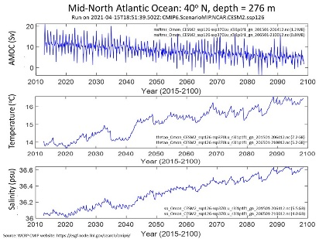
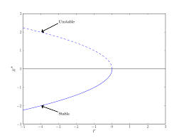
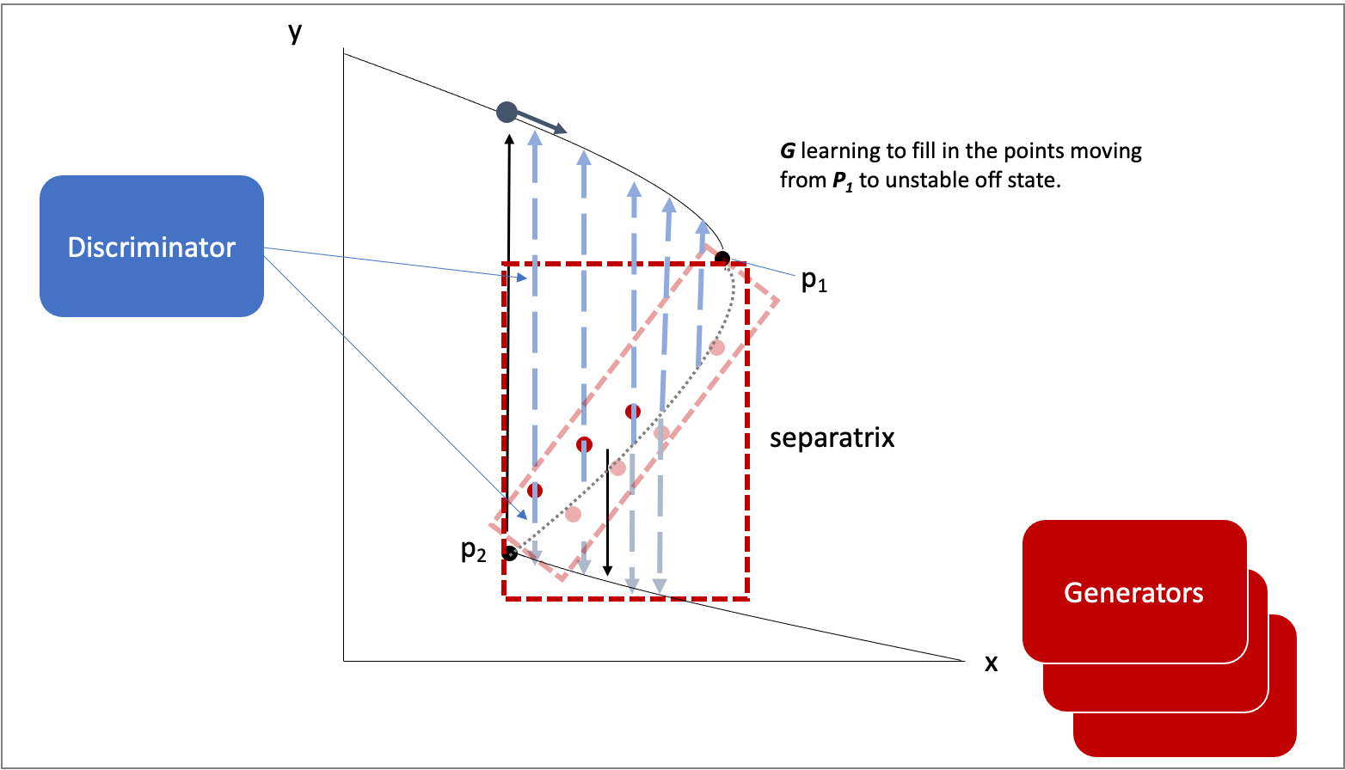
Goals
The Physics-informed AI Climate Model Agent Neuro-symbolic Simulator (PACMANS) for Tipping Point Discovery
Build a new climate tipping point dataset for AI exploration
Extend Kevrekidis’ work that enables tipping point discovery for coarse surrogate models using bifurcation and use it for neural unsupervised exploration
Build a general machinery for tipping point discovery based on a novel adversarial game approach

Slide 9
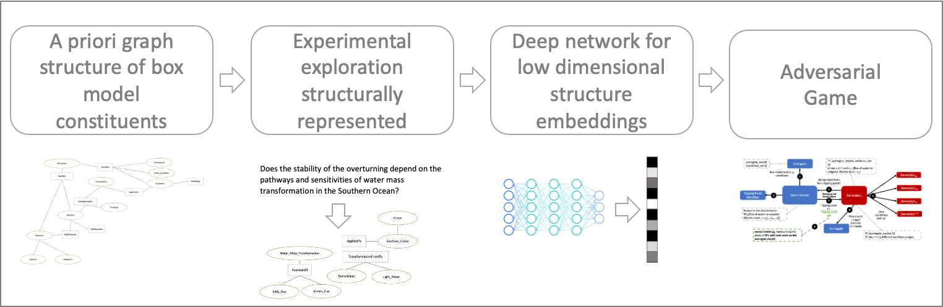
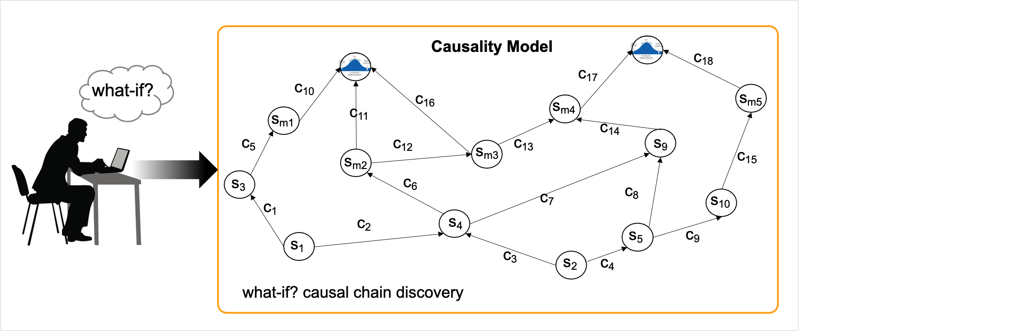

Goals
The Physics-informed AI Climate Model Agent Neuro-symbolic Simulator (PACMANS) for Tipping Point Discovery
Create a proof-of-concept climate neuro-symbolic language to represent problems that map modeler-specific problems into a symbolic representation that can be reasoned upon
Use the neuro-symbolic language and neural exploration to build causal paths that can be reasoned upon and provide AI explainability that can be used to reduce computations of large climate model ensembles that prohibit explorative tipping point studies
Apply this methodology to the AMOC use case

Slide 10
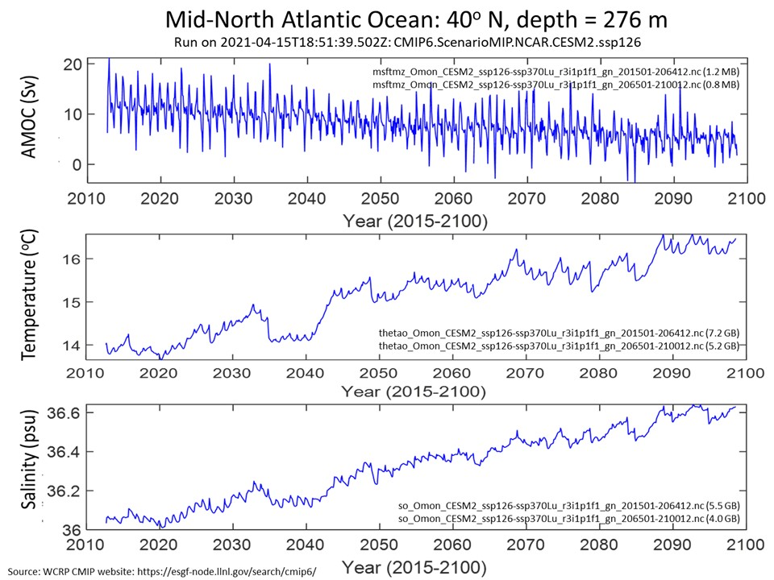
Build a new climate tipping point dataset

Slide 11
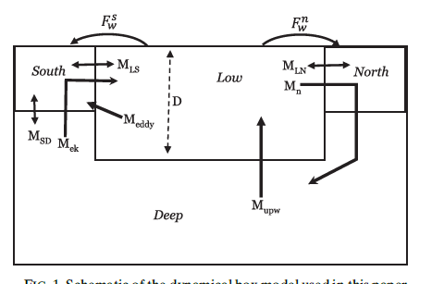
Surrogate Climate Models
The Physics-informed AI Climate Model Agent Neuro-symbolic Simulator (PACMANS) for Tipping Point Discovery
On long time scales, Atlantic overturning can often be described by simple box model…
… which exhibits tipping points.
We use the box model as a first-step data set
We then extend this to include the larger climate models
Extend to include Pacific Basin
Calibrate model against specific climate models (NCAR+CMIP6) using preindustrial and historical simulations.
Show that model can capture both mean state and variability
Use surrogate model to project tipping points, examine for accuracy of prediction.
Gnanadesikan, 1999; Gnanadesikan, Kelson and Sten, J. Climate 2018

Slide 12
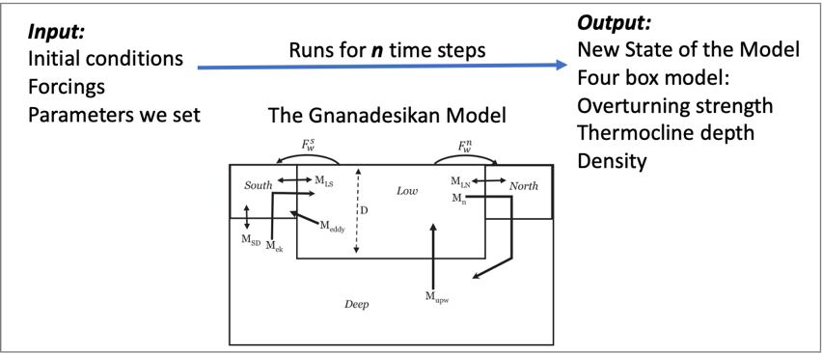
The Gnanadesikan Four Box Model
The Physics-informed AI Climate Model Agent Neuro-symbolic Simulator (PACMANS) for Tipping Point Discovery
Using the Four Box Model as a way to generate data for the AI methods
For long time scales, Atlantic overturning can often be described by simple box model
The Gnanadesikan Four Box Model

Slide 13
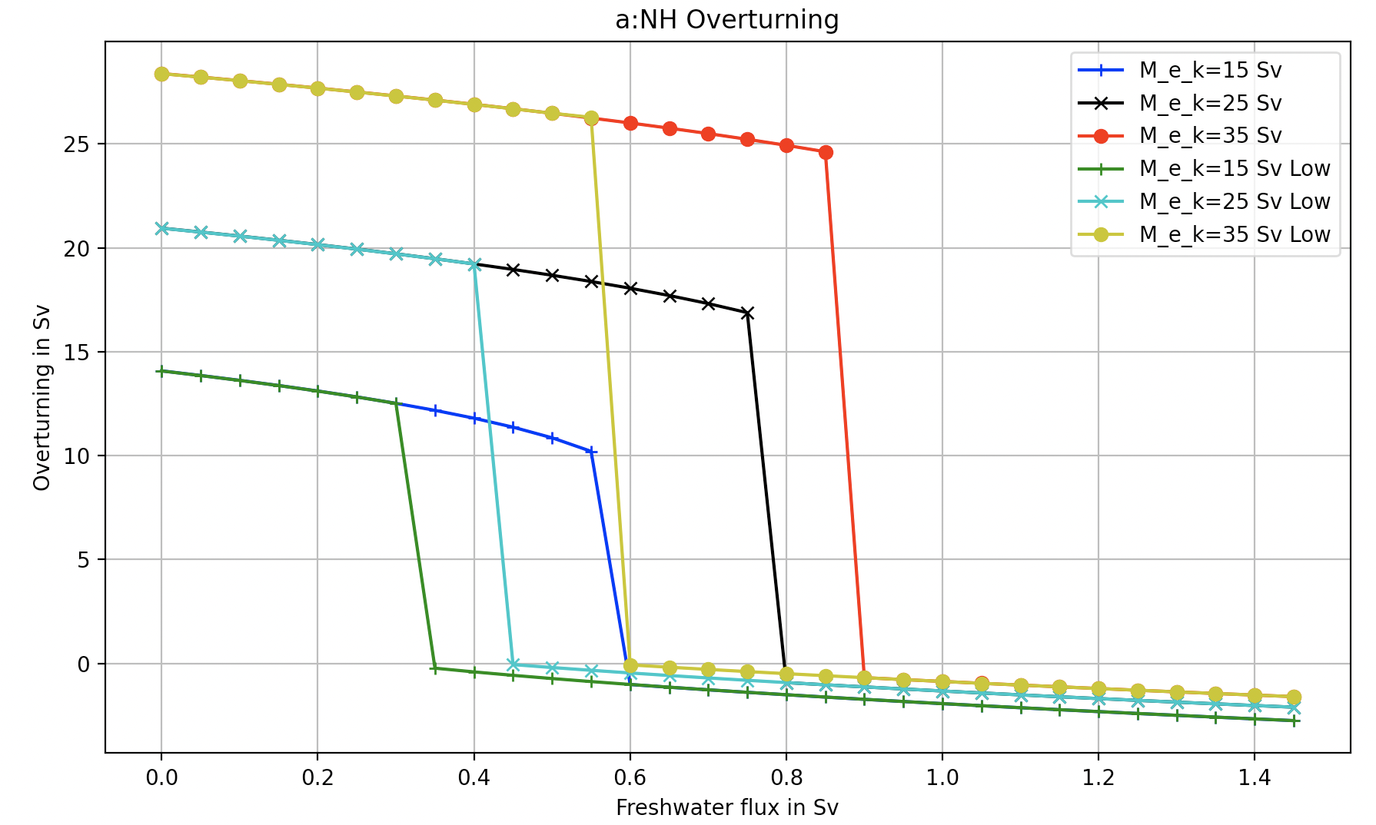
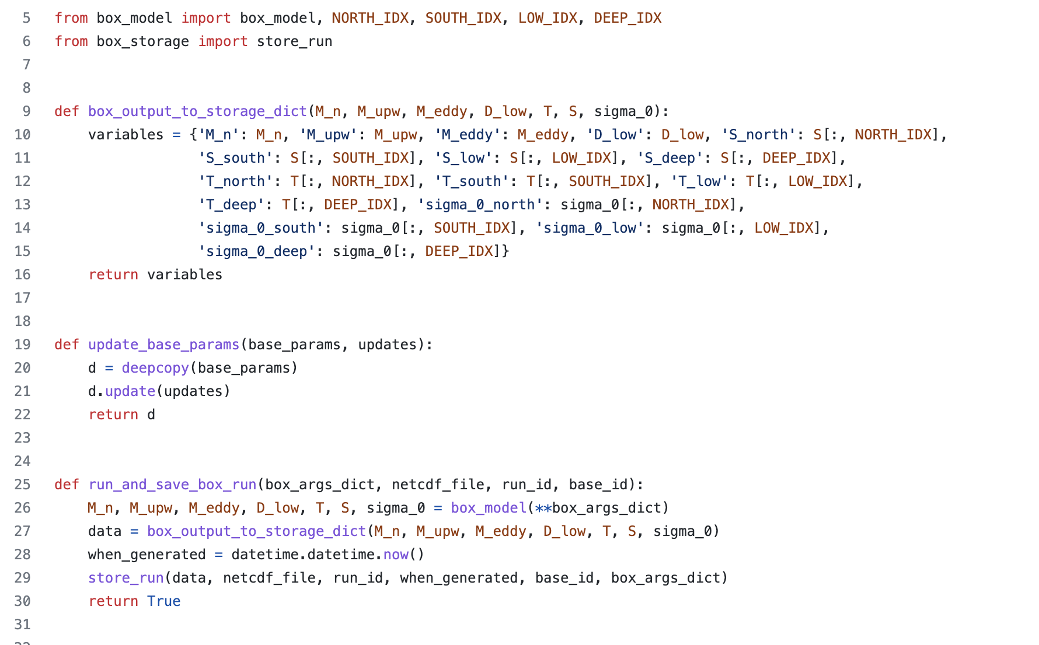
The Gnanadesikan Four Box Model
The Physics-informed AI Climate Model Agent Neuro-symbolic Simulator (PACMANS) for Tipping Point Discovery
Created a python package of the four box model that allows one to specify initial conditions, and parameter values
The python package recreates the Gnanadesikan experiments (in Matlab code)
Generates the same plots
Enables creation of labeled training data for training machine learning algorithms and temporal training data for training the AI surrogates
Produces datasets in netcdf format

Slide 14
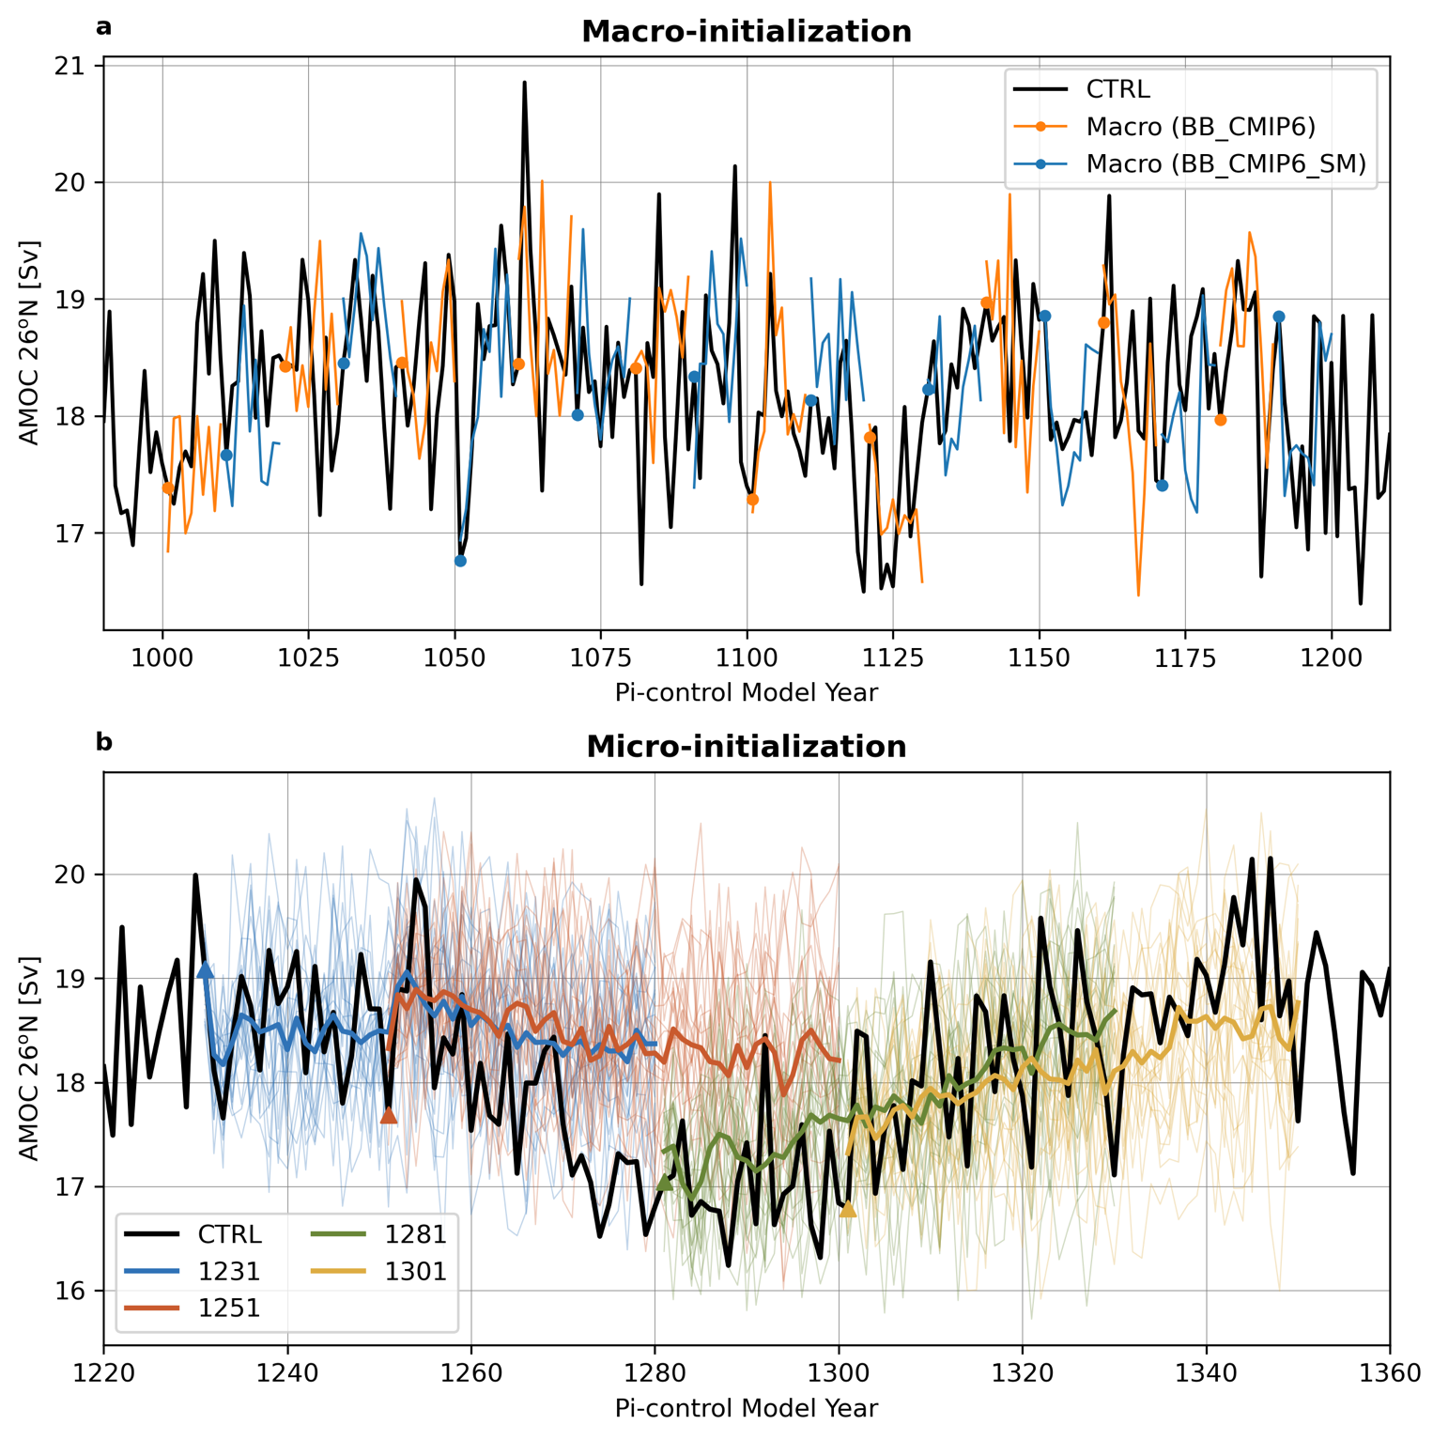
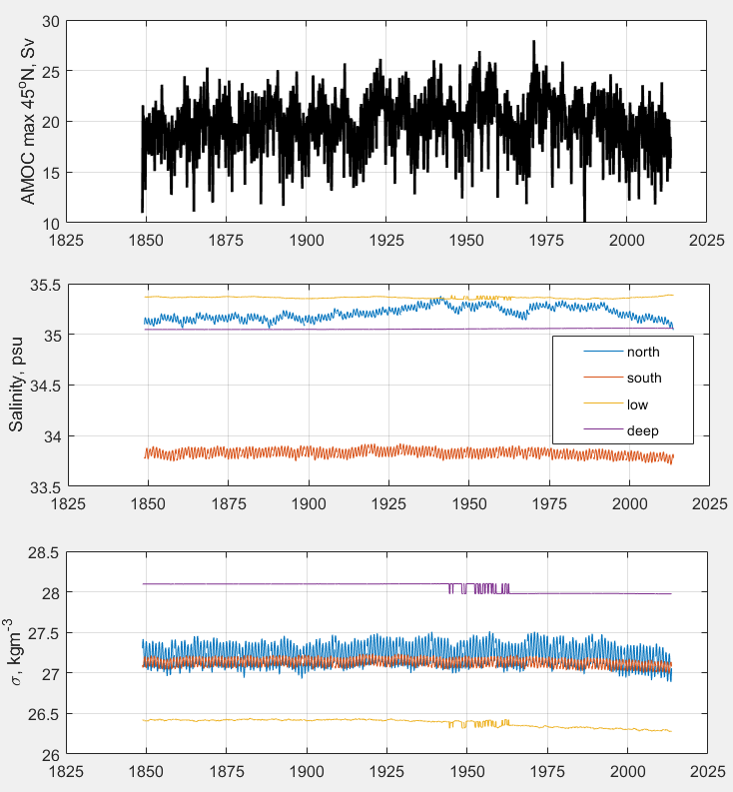
Mapping CMIP6 to the Box Model
The Physics-informed AI Climate Model Agent Neuro-symbolic Simulator (PACMANS) for Tipping Point Discovery
CESM2 Large Ensemble
CESM2-LE initialization consequences for the Atlantic Meridional Overturning Circulation (AMOC) at 26.5°N with 20 macro-initializations (top) and the micro-initializations (bottom)
Pre-industrial run from 1001

Slide 15
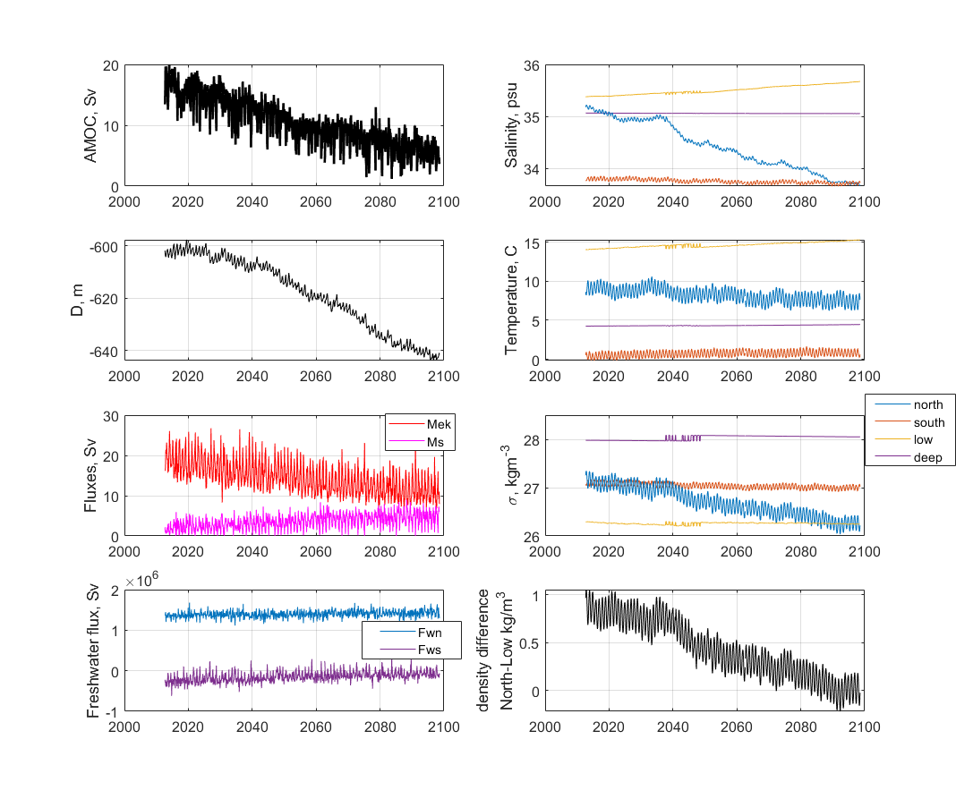
Mapping CMIP6 to the Box Model
The Physics-informed AI Climate Model Agent Neuro-symbolic Simulator (PACMANS) for Tipping Point Discovery
Initial data wrangling included converting 4-dimensional ocean variables of temperature, salinity, and velocity into zonal-mean (3-dimensional) temperature, salinity, potential density, and velocity. 4GB and 3 cpu-hours per decade.
Zonal-mean variables processed into 1-dimensional time series parallel to those created by the Gnanadesikan Four Box Model
Matlab code generates netcdf output from the CESM-2 model runs for ML algorithms

Slide 16
Extend Kevrekidis’ work that enables tipping point discovery for coarse surrogate models using bifurcation

Slide 17
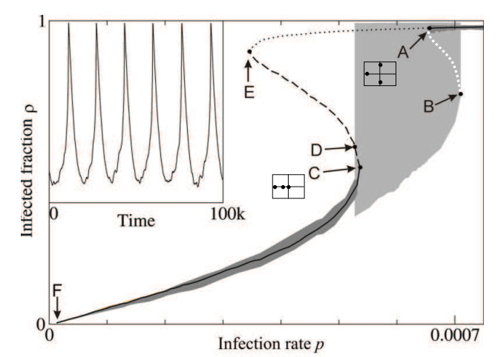
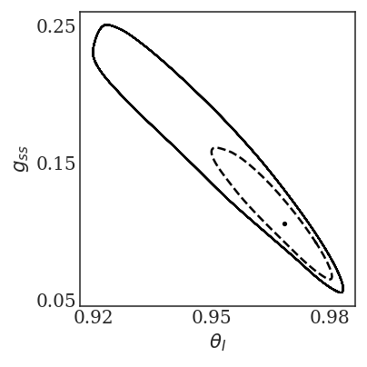
AI Surrogates and Bifurcation – Methodology Plan
The Physics-informed AI Climate Model Agent Neuro-symbolic Simulator (PACMANS) for Tipping Point Discovery
Tipping point computation plan for the stochastic Box model:
Developing one-parameter bifurcation diagrams of the (deterministic part) of the box model (9 differential equations) with respect to the separate parameters
In neighborhood of tipping point, the model reduces to an effectively one-dimensional model since one eigenvalue is close to zero
Then stochastic simulations will give rise to time series “jumping” across different states
(Gross T. et al 2008) System-level bifurcation diagram.
A phase portrait in the physical coordinates $θ_{Ι}$and $g_{ss}$

Slide 18
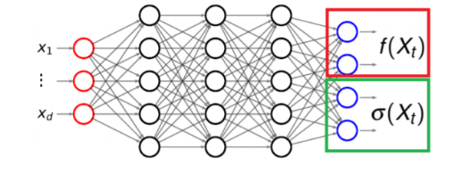
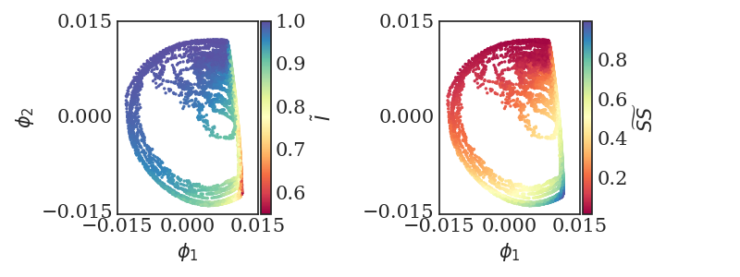
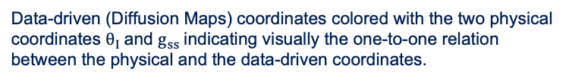
AI Surrogates and Bifurcation – Methodology Plan
The Physics-informed AI Climate Model Agent Neuro-symbolic Simulator (PACMANS) for Tipping Point Discovery
Tipping point computation plan for the stochastic Box model:
Reduced set of models focused on areas around tipping points
Trained to learn tipping points using coarse bifurcation signatures
Data-driven method using machine learning
Neural network architecture used to learn the drift and diffusivity of the stochastic differential equation.
Data-driven (Diffusion Maps) coordinates colored with the two physical coordinates $θ_{Ι}$and $g_{ss}$indicating visually the one-to-one relation between the physical and the data-driven coordinates.

Slide 19
Build a general machinery for tipping point discovery

Slide 20
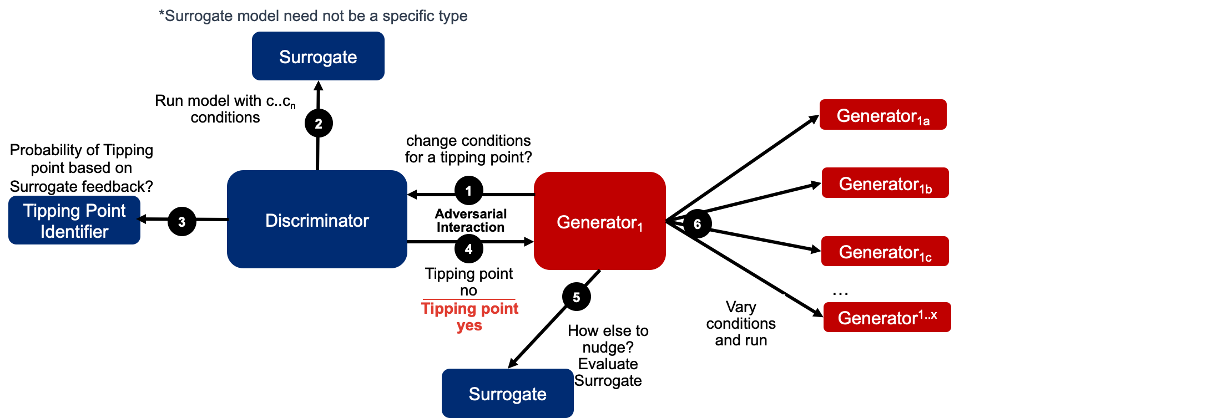
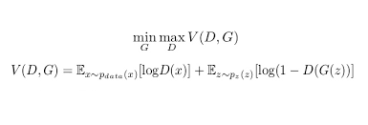
Multi-Generator GAN Simulation
The Physics-informed AI Climate Model Agent Neuro-symbolic Simulator (PACMANS) for Tipping Point Discovery
Using a GAN with multiple generators
Generators perturb parameters to invoke a collapse
Discriminator learns how to adjust additional parameters to avoid collapse
Box model is the surrogate to start
Interactions between the discriminator and the generator seeking to exploit tipping points

Slide 21
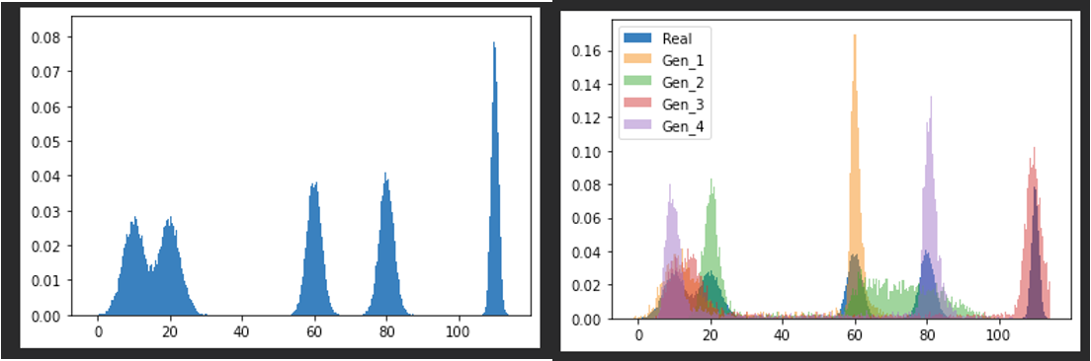
Multi-Generator GAN Simulation
The Physics-informed AI Climate Model Agent Neuro-symbolic Simulator (PACMANS) for Tipping Point Discovery
Early experimentation involved learning more about the adversarial setup with multiple generators
Built a GAN using MAD-GAN architecture
Our early experiment of a 1-D non-parametric density estimation using MAD-GAN
5-component 1-D Gaussian Mixture Model (GMM) (left) and overlay of a Sample of Generator Outputs (4) (left) after 50,000 updates

Slide 22
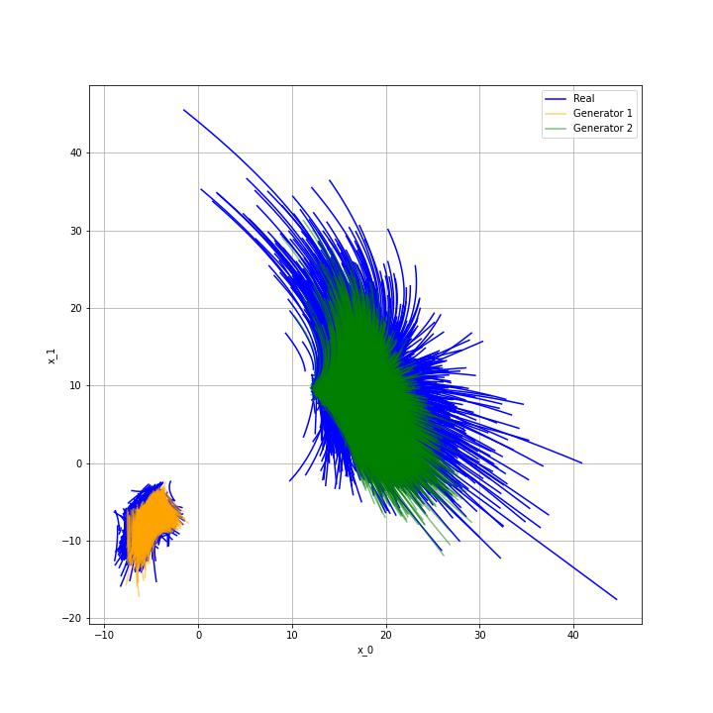
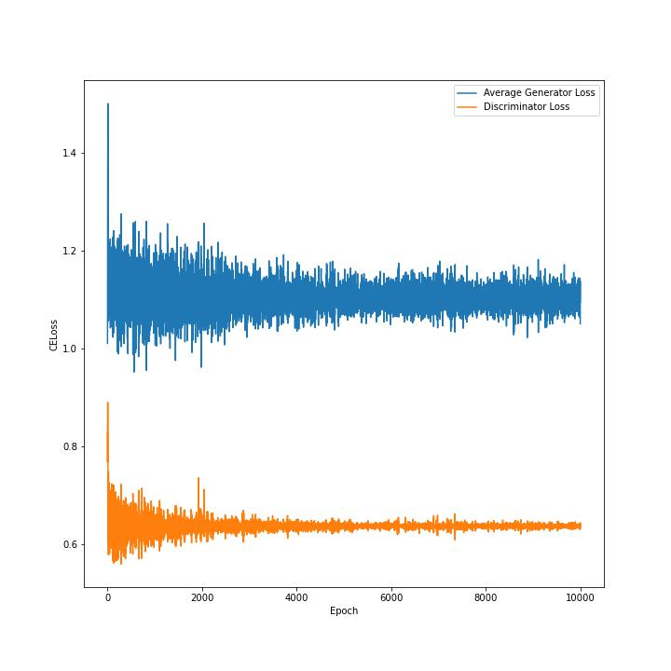
Multi-Generator GAN Simulation
The Physics-informed AI Climate Model Agent Neuro-symbolic Simulator (PACMANS) for Tipping Point Discovery
GAN architecture using a 2-D system of ODEs (dx_0/dt, dx_1/dt)
Two “clusters” of solutions
Sample initial conditions and parameters from each cluster
Trained GAN using two generators
Two Generator GAN Loss Plot (left) based on 2-D System of ODEs and Generator Output Overlaid on Samples from Numerically Solved Dataset.

Slide 23
Create a proof-of-concept climate neuro-symbolic language for mapping problems, enabling causality, and supporting explainability

Slide 24
Neuro-Symbolic Language Exploration
The Physics-informed AI Climate Model Agent Neuro-symbolic Simulator (PACMANS) for Tipping Point Discovery

Slide 25
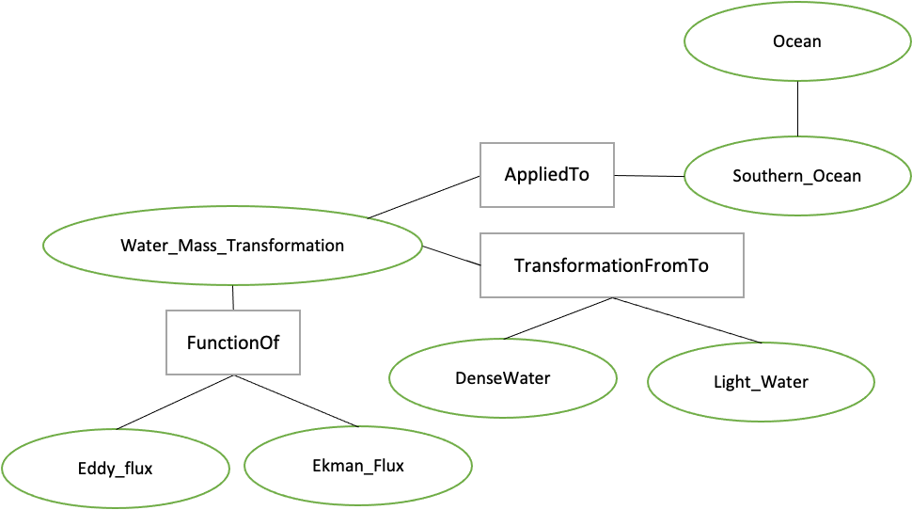
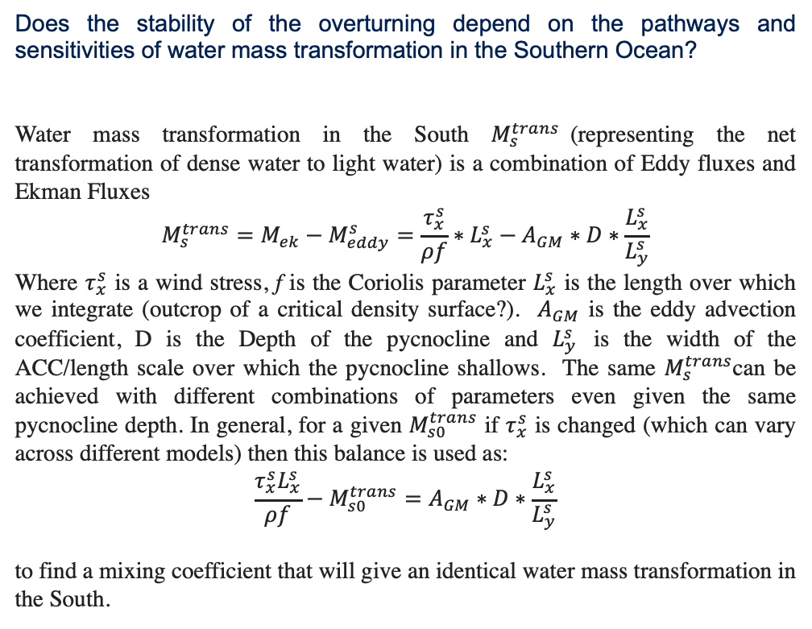
Neuro-Symbolic Language Exploration
The Physics-informed AI Climate Model Agent Neuro-symbolic Simulator (PACMANS) for Tipping Point Discovery
Does the stability of the overturning depend on the pathways and sensitivities of water mass transformation in the Southern Ocean?
Water mass transformation in the South $M_{s}^{trans}$(representing the net transformation of dense water to light water) is a combination of Eddy fluxes and Ekman Fluxes
$${M_{s}^{trans}=M_{ek}−M}_{eddy}^{s}=\frac{τ_{x}^{s}}{ρf}∗L_{x}^{s}−A_{GM}∗D∗\frac{L_{x}^{s}}{L_{y}^{s}}$$
Where $τ_{x}^{s}$ is a wind stress, f is the Coriolis parameter $L_{x}^{s}$ is the length over which we integrate (outcrop of a critical density surface?). $A_{GM}$ is the eddy advection coefficient, D is the Depth of the pycnocline and $L_{y}^{s}$ is the width of the ACC/length scale over which the pycnocline shallows. The same $M_{s}^{trans}$can be achieved with different combinations of parameters even given the same pycnocline depth. In general, for a given $M_{s0}^{trans}$ if $τ_{x}^{s}$ is changed (which can vary across different models) then this balance is used as:
$$\frac{τ_{x}^{s}L_{x}^{s}}{ρf}−M_{s0}^{trans}=A_{GM}∗D∗\frac{L_{x}^{s}}{L_{y}^{s}}$$
to find a mixing coefficient that will give an identical water mass transformation in the South.
Translation of a question symbolically
Mapping the question to box model parameters

Slide 26
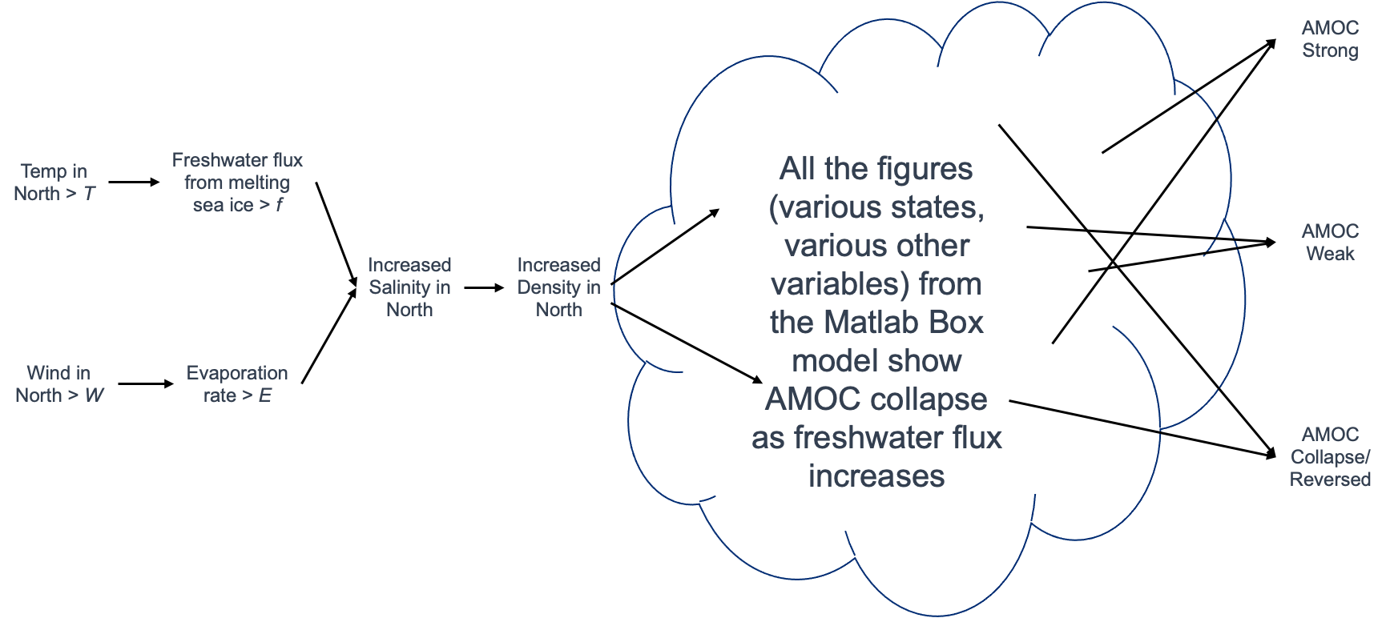
Causal Model
The Physics-informed AI Climate Model Agent Neuro-symbolic Simulator (PACMANS) for Tipping Point Discovery
Learning Higher Levels of Abstraction from Learned Latent Space of the Generators – More Interesting Outcomes (Weakness/Strength)
20 April 2022

Slide 27
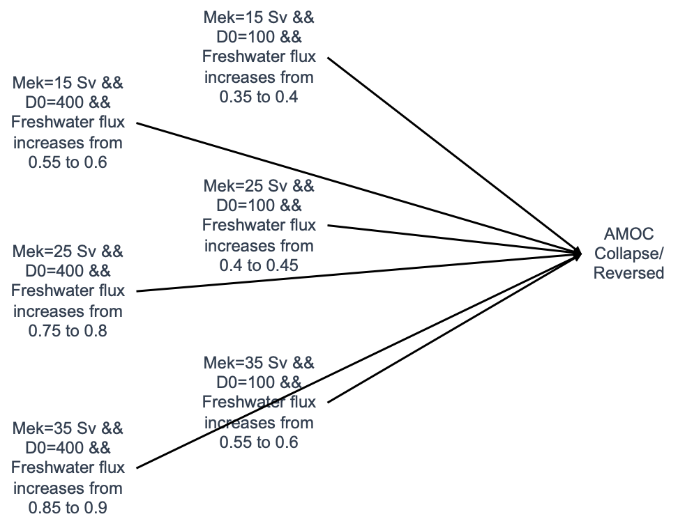
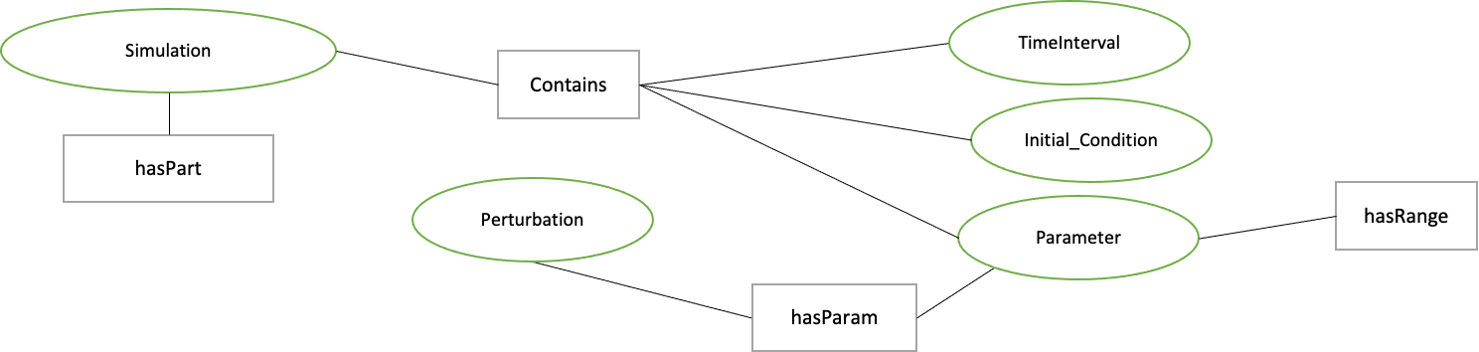
Causal Model
The Physics-informed AI Climate Model Agent Neuro-symbolic Simulator (PACMANS) for Tipping Point Discovery
Understand the power of mapping what is learned by generators to what is known a priori
Using box model runs to model initial conditions/parameters configurations that lead to collapse into a hypothetical causal model for analysis
Subset of Graphical Structure of a Simulation
Example Problem Of AMOC Collapse from the Four Box Model
20 April 2022

Slide 28
Approach/Schedule/Milestones/Deliverables (FY22)
The Physics-informed AI Climate Model Agent Neuro-symbolic Simulator (PACMANS) for Tipping Point Discovery
20 April 2022

Slide 29
Expected Outcomes
The Physics-informed AI Climate Model Agent Neuro-symbolic Simulator (PACMANS) for Tipping Point Discovery
Build a general machinery for learning climate tipping points
- Develop new ideas for architectures related to Generative Adversarial Networks (GANs)
Build a neuro-symbolic language for the AMOC Q&A
- Contribute to the new research emerging in this area
Build AI surrogate models for bifurcation discovery
- Gain insight into model resolution and creating reduced climate models
Learn new insights into the potential collapse of the AMOC
Learn new insights into model disagreement of the AMOC
- Model disagreement for a single model and across models - oceanographers cannot answer this question currently
Develop new collaborations in this space
- The ACTM teams are working with other climate tipping points – it would be good to apply our methodology on other problems
20 April 2022

Slide 30
Summary
In summary, consistent research progress in each area of the proposed hybrid climate system
With Milestone 3 we will release version 1 of our data generation tools for both the Four Box model and the CMIP Four Box model mapped datasets
Version 1 of the GAN and version 1 of the surrogate/bifurcation work are on target for Milestone 4
Thank you and we will take questions at this point.
Progress

Slide 31
Citations
1. Boers, Niklas. "Observation-based early-warning signals for a collapse of the Atlantic Meridional Overturning Circulation." Nature Climate Change 11, no. 8 (2021): 680-688.
2. Gnanadesikan, A., A simple model for the structure of the oceanic pycnocline, Science., 283:2077-2079, (1999).
3. Forget, G., J.-M. Campin, P. Heimbach, C. N. Hill, R. M. Ponte, C. Wunsch, ECCO version 4: An integrated framework for non-linear inverse modeling and global ocean state estimation. Geosci. Model Dev. 8, 3071–3104 (2015)
4. Gnanadesikan, A., R. Kelson and M. Sten, Flux correction and overturning stability: Insights from a dynamical box model, J. Climate, 31, 9335-9350, https://doi.org/10.1175/JCLI-D-18-0388.1, (2018).
5. Kaufhold, John Patrick, and Jennifer Alexander Sleeman. "Systems and methods for deep model translation generation." U.S. Patent No. 10,504,004. 10 Dec. 2019.
6. Garcez, Artur d'Avila, and Luis C. Lamb. "Neurosymbolic AI: the 3rd Wave." arXiv preprint arXiv:2012.05876 (2020).
7. Stommel, H. Thermohaline convection with two stable regimes of flow. Tellus 13, 224–230 (1961).
8. Karniadakis, George Em, Ioannis G. Kevrekidis, Lu Lu, Paris Perdikaris, Sifan Wang, and Liu Yang. "Physics-informed machine learning." Nature Reviews Physics 3, no. 6 (2021): 422-440.
9. Sleeman, Jennifer, Milton Halem, Zhifeng Yang, Vanessa Caicedo, Belay Demoz, and Ruben Delgado. "A Deep Machine Learning Approach for LIDAR Based Boundary Layer Height Detection." In IGARSS 2020-2020 IEEE International Geoscience and Remote Sensing Symposium, pp. 3676-3679. IEEE, 2020.
10. Patel, Kinjal, Jennifer Sleeman, and Milton Halem. "Physics-aware deep edge detection network." In Remote Sensing of Clouds and the Atmosphere XXVI, vol. 11859, pp. 32-38. SPIE, 2021.
11.Brulé, Joshua. "A causation coefficient and taxonomy of correlation/causation relationships." arXiv preprint arXiv:1708.05069 (2017).
12. Rasp, Stephan, Michael S. Pritchard, and Pierre Gentine. "Deep learning to represent subgrid processes in climate models." Proceedings of the National Academy of Sciences 115, no. 39 (2018): 9684-9689.
13. Bolton, Thomas, and Laure Zanna. "Applications of deep learning to ocean data inference and subgrid parameterization." Journal of Advances in Modeling Earth Systems 11, no. 1 (2019): 376-399.
14. Kurth, Thorsten, Sean Treichler, Joshua Romero, Mayur Mudigonda, Nathan Luehr, Everett Phillips, Ankur Mahesh et al. "Exascale deep learning for climate analytics." In SC18: International Conference for High Performance Computing, Networking, Storage and Analysis, pp. 649-660. IEEE, 2018.

Slide 32
Citations cont.
15. Weber, Theodore, Austin Corotan, Brian Hutchinson, Ben Kravitz, and Robert Link. "Deep learning for creating surrogate models of precipitation in Earth system models." Atmospheric Chemistry and Physics 20, no. 4 (2020): 2303-2317.
16. Matsubara, Takashi, Ai Ishikawa, and Takaharu Yaguchi. "Deep energy-based modeling of discrete-time physics." arXiv preprint arXiv:1905.08604 (2019).
17. Kleinen, T., Held, H. & Petschel-Held, G. The potential role of spectral properties in detecting thresholds in the Earth system: application to the thermohaline circulation. Ocean Dyn. 53, 53–63 (2003).
18. Kocaoglu, Murat, Christopher Snyder, Alexandros G. Dimakis, and Sriram Vishwanath. "Causalgan: Learning causal implicit generative models with adversarial training." arXiv preprint arXiv:1709.02023 (2017).
19. Feinman, Reuben, and Brenden M. Lake. "Learning Task-General Representations with Generative Neuro-Symbolic Modeling." arXiv preprint arXiv:2006.14448 (2020).
20. Yi, Kexin, Chuang Gan, Yunzhu Li, Pushmeet Kohli, Jiajun Wu, Antonio Torralba, and Joshua B. Tenenbaum. "Clevrer: Collision events for video representation and reasoning." arXiv preprint arXiv:1910.01442 (2019).
21. Nowack, Peer, Jakob Runge, Veronika Eyring, and Joanna D. Haigh. "Causal networks for climate model evaluation and constrained projections." Nature communications 11, no. 1 (2020): 1-11.
22. Andersson, Tom R., J. Scott Hosking, María Pérez-Ortiz, Brooks Paige, Andrew Elliott, Chris Russell, Stephen Law et al. "Seasonal Arctic sea ice forecasting with probabilistic deep learning." Nature communications 12, no. 1 (2021): 1-12.
23. Storchan, Victor, Svitlana Vyetrenko, and Tucker Balch. "MAS-GAN: Adversarial Calibration of Multi-Agent Market Simulators." (2020).
24. De Raedt, Luc, Robin Manhaeve, Sebastijan Dumancic, Thomas Demeester, and Angelika Kimmig. "Neuro-symbolic=neural+ logical+ probabilistic." In NeSy'19@ IJCAI, the 14th International Workshop on Neural-Symbolic Learning and Reasoning. 2019.
25. Eyring, V., Bony, S., Meehl, G. A., Senior, C. A., Stevens, B., Stouffer, R. J., and Taylor, K. E.: Overview of the Coupled Model Intercomparison Project Phase 6 (CMIP6) experimental design and organization, Geosci. Model Dev., 9, 1937-1958, doi:10.5194/gmd-9-1937-2016, 2016.
26. Swingedouw, Didier, Chinwe Ifejika Speranza, Annett Bartsch, Gael Durand, Cedric Jamet, Gregory Beaugrand, and Alessandra Conversi. "Early warning from space for a few key tipping points in physical, biological, and social-ecological systems." Surveys in geophysics 41, no. 6 (2020): 1237-1284.
27. Reichstein, Markus, Gustau Camps-Valls, Bjorn Stevens, Martin Jung, Joachim Denzler, and Nuno Carvalhais. "Deep learning and process understanding for data-driven Earth system science." Nature 566, no. 7743 (2019): 195-204.

Slide 33
Citations cont.
28. Sleeman, Jennifer, Ivanka Stajner, Christoph Keller, Milton Halem, Christopher Hamer, Raffaele Montuoro, and Barry Baker. "The Integration of Artificial Intelligence for Improved Operational Air Quality Forecasting." In AGU Fall Meeting 2021. 2021.
29. Bellomo, K., Angeloni, M., Corti, S. et al. Future climate change shaped by inter-model differences in Atlantic meridional overturning circulation response. Nat Commun 12, 3659 (2021). https://doi.org/10.1038/s41467-021-24015-w
30. Sgubin, G., Swingedouw, D., Drijfhout, S. et al. Abrupt cooling over the North Atlantic in modern climate models. Nat Commun 8, 14375 (2017). https://doi.org/10.1038/ncomms14375
31. Swingedouw, D., Bily, A., Esquerdo, C., Borchert, L. F., Sgubin, G., Mignot, J., & Menary, M. (2021). On the risk of abrupt changes in the North Atlantic subpolar gyre in CMIP6 models. Annals of the New York Academy of Sciences, 1504(1), 187-201. https://doi.org/10.1111/nyas.14659
32. Mao, Jiayuan, Chuang Gan, Pushmeet Kohli, Joshua B. Tenenbaum, and Jiajun Wu. "The neuro-symbolic concept learner: Interpreting scenes, words, and sentences from natural supervision." arXiv preprint arXiv:1904.12584 (2019).
This material is based upon work supported by the Defense Advanced Research Projects Agency (DARPA) under Agreement No. HR00112290032.

